Slide 1
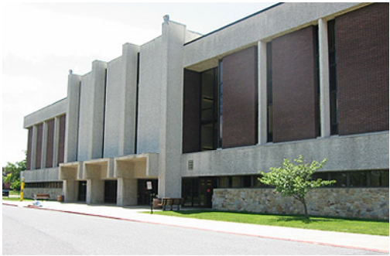
College of Science and Mathematics
Department of Computer Science
Dr. Vasil Hnatyshin
Department Head
Advising brochures also available online at:
https://rucsm.org/cs/advising/brochures/
Fall 2017

Slide 2
Computer Science Department
Nationally accredited B.S. program by Accreditation Board for Engineering and Technology (ABET): http://www.abet.org/
Very vibrant and fun department
Faculty are friendly and accessible
All CS classes are small
Students have lots of opportunities for one-on-one interaction with faculty
Every student has a full-time faculty advisor
Curriculum includes a lot of Programming, Computing, and Math Courses
http://www.rowan.edu/cs
WWW Map for
“Exotic Vacations”

Slide 3
Computer Science Department
Students have many opportunities to conduct research under faculty supervision
    Annual Rowan University Science, Technology, Engineering, & Math (STEM) Student Research Symposium
    CSM’s Summer Undergraduate Research Program
    Student present their work at the regional, national, and international conferences
Getting a degree or a minor in CS will most definitely help the graduate securing the job.
According to U.S. Department of Labor Bureau of Labor Statistics computer related jobs will experience significant growth
WWW Map for
“Exotic Vacations”

Slide 4
Overview of Programs
Undergraduate BS Degree
BS Computer Science
Computer Science Minor
Data Analytics Minor
Specializations:
  Software Engineering
  Networking Systems
  Information Technology
  Programming Languages and Compilers
  Data Analytics
  Artificial Intelligence
  Graphics, Visualization and Gaming Tech
  Cyber Security
  Mobile Application Development
Certificate of Undergraduate Study (CUGS)
Undergraduate BA Degree
  BA in Computing and Informatics
  More applied programming;
  less math and computer theory
  Specializations:
  Mobile Devices
  "DevOps“
  Cyber Security
Graduate Programs
  MS in Computer Science
  BS/MS in CS (Accelerated)
  BS/MS in DA (Accelerated)
  Certificate of Graduate Study (COGS)
  MS Degree in Data Analytics
  MS Specialization in Health Data Analytics
  MS Specialization and COGS in Cyber Security

Slide 5
B.S. in Computer Science
Computer Science program focuses on developing flexible professionals who are equipped to learn new technologies and principles that are essential for success in such a rapidly evolving field.
Students learn how to apply advanced scientific and industrial methodologies to develop computing solutions.
Computer scientists are employed as software engineers, system and application programmers, systems analysts, programmer analysts, researchers, network specialists, computer system designers, system administrators, etc.
Job opportunities exist in business, industry, government, education and the military.

Slide 6
B.S. in Computer Science
The curriculum for the major consists of a set of core courses covering such areas as:
  discrete mathematics
  calculus and linear algebra
  probability and statistics
  object-oriented programming
  data structures and algorithms
  computer architecture
  circuitry and hardware fundamentals
  computer science theory
  software engineering
  programming languages
  operating systems
Students also choose from over 30 electives on a wide variety of topics including computer game development, robotics, computer animation, network security, mobile and web development, distributed systems, human-computer interaction and more.

Slide 7
B.A. in Computing and Informatics
The Bachelor of Arts in Computing and Informatics is a new degree designed for students who are interested in pursuing careers in information technology which requires a solid understanding of the principles of computing – but not the underpinnings of computer science theory and mathematics.
Such careers include, but are not limited to:
Programmers
Infrastructure Administrators
Support Technicians (e.g., Help Desk support)
Technical Application Trainers
Software QA / Testing Engineers
Computer Service Coordinators
Deployment Technicians (e.g., end-user support for system releases)
Technical Documentation Specialists

Slide 8
MS/BS Dual Degree in
Computer Science
BS/MS/CS program: The complete accelerated Bachelor of Science/Master of Science in Computer Science Dual Degree Program
At the completion of the program the student receives both a BS in Computer Science and an MS in Computer Science.
The student takes 12 credits fewer than if he/she would have obtained the degrees separately
BS/MS students take 12 credits of graduate courses during their senior year
WWW Map for
“Exotic Vacations”
Notes:
9

Slide 9
MS/BS Dual Degree in
Data Analytics
BS/MS/DA program: The complete accelerated Bachelor of Science in Computer Science / Master of Science in Data Analytics Dual Degree Program
At the completion of the program the student receives both a BS in Computer Science and an MS in Data Analytics.
The student takes 12 credits fewer than if he/she would have obtained the degrees separately
BS/MS students take 12 credits of graduate courses during their senior year

Slide 10
Masters Degree in CS from
Rowan University
The MS in Computer Science is a 30 credit hour program with an optional thesis track.
Required course-load: a 12-credit core courses.
Thesis Track:
  12 additional credits of restricted electives and
  the 6-credit thesis sequence
Non-thesis Track:
  18 additional credits of restricted electives,
  6 credits of which must be classified as project intensive.
WWW Map for
“Exotic Vacations”
Notes:
11

Slide 11
Masters Degree in DA from
Rowan University
The MS in Data Analytics is a 30 credit hour program
Required course-load:
  12 credit core courses
  12 additional credits in a specialized area
  6 additional restricted electives
We currently offer a concentration in Health Data Analytics with more concentrations in the works!

Slide 12

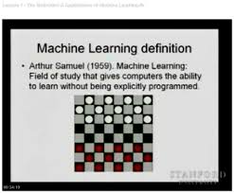
Faculty
Baliga, Ganesh, Ph.D.
  Machine learning, object oriented design and modeling, web computing
Bergmann, Seth D., M.S.E.
  Programming language design and implementation, data locality in sorting algorithms
Hristescu, Gabriela, Ph.D.
  Computational biology, databases, parallel and distributed computing, artificial intelligence

Slide 13
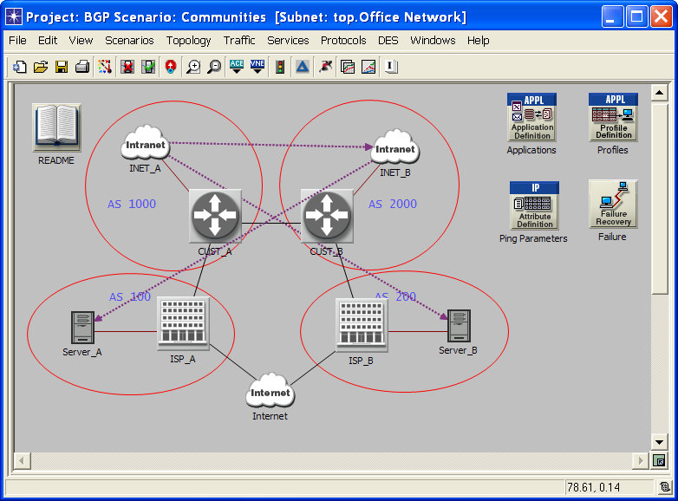
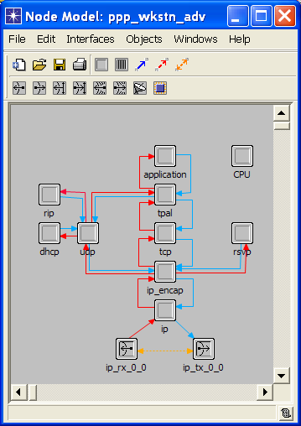
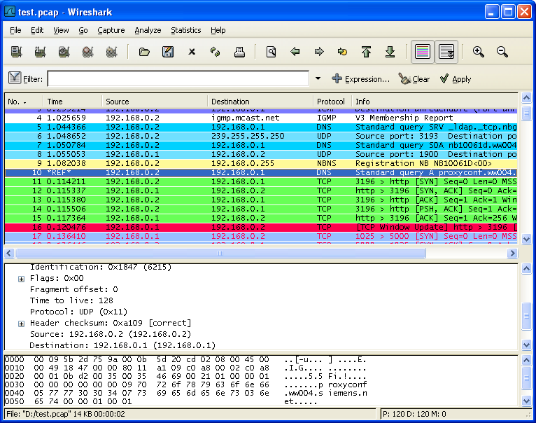
Faculty
Hnatyshin, Vasil, Ph.D.
  Internet and TCP/IP protocol suite, Mobile ad hoc Networks and Wireless Communication, Simulation and Modeling of Computer Networks, Cyber Security
Lobo, Andrea F., Ph.D.
  Wireless networks, protocols & applications, Internet protocols & applications, computer network performance, systems modeling and simulation
Myers, Jack F., MS in CS
  Human-Computer Interaction, Software Engineering, Object-Oriented Programming, Databases
  Web programming

Slide 14

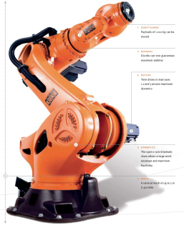
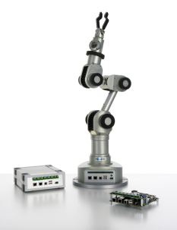
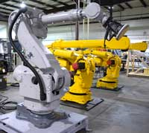
Faculty
Kay, Jennifer, Ph.D.
  Educational Robotics, Computer Science Education, Robotics, Vehicle Teleoperation, Human-Computer Interaction, User Interfaces, Cryptography, Artificial Intelligence.
Robinson, John, Ed.D.
  Computer networking, Web/CGI programming, object-oriented design & programming, hardware design/VHDL computer science education
Breitzman, Anthony Ph.D.
  Data Analytics, Data Mining, Web/Text Mining, Sentiment Analysis, Databases, Convolution Algorithms, Number Theory
Industrial Robot Manipulators

Slide 15



Faculty
Ho, Shen-Shyang, Ph.D
  Spatiotemporal Data Mining, Machine Learning, Artificial Intelligence, Pattern Recognition Data Science, Privacy Issues in Data Mining
Tinkham, Nancy L., Ph.D.
  Artificial intelligence, theoretical computer science, inductive logic programming, computational linguistics, computer science education
Xu, Jianning, Ph.D.
  Computer image processing, pattern recognition, mathematical morphology

Slide 16
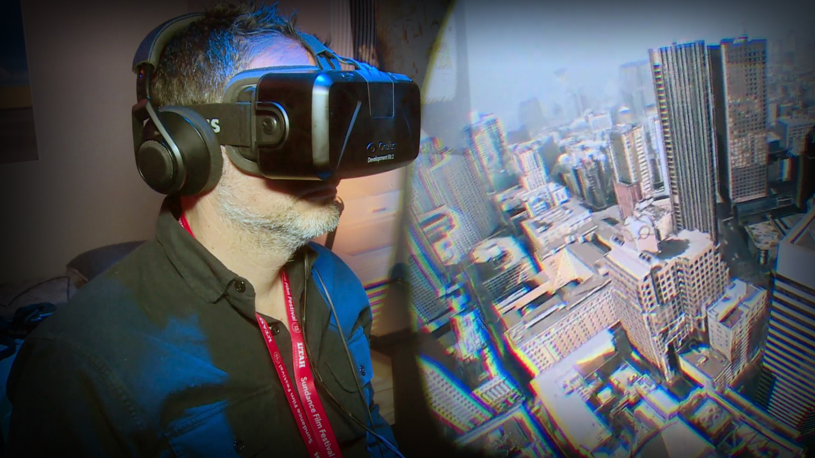



Faculty
Sun, Bo, Ph.D.
  Data Visualization, Serious Gaming, and Virtual Reality/Augmented Reality-based Simulation.
Heydari, Vahid, Ph.D.
  Moving Target Defenses, IPv6 Security, Mobile and Wireless Networks Security, and Wireless Networks Analysis and Simulation.

Slide 17

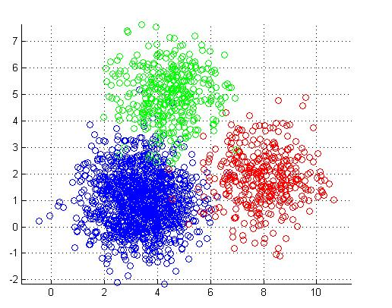

Selected Grants and Collaboration Projects
Andrea Lobo and Ganesh Baliga
  National Science Foundation, NSF-TUES grant award
  Learning Algorithm Design: Project-Based Curriculum
  Software Development for Perka

Slide 18




Selected Grants and Collaboration Projects
  Vasil Hnatyshin and Umashanger Thayasivam
  Statistical & Machine Learning techniques
  for analysis of pharmaceutical data
  Bristol Myers Squibb
Jennifer Kay
  Rowan Computer Science For High Schools
  Google Corporation
  John Robinson, Anthony Breitzman, and Jack Myers
  Software Development Collaboration

Slide 19
College of Science and Mathematics
Department of Computer Science
Dr. Vasil Hnatyshin
Department Head
Advising brochures also available online at:
https://rucsm.org/cs/advising/brochures/
Fall 2017

